Slide 1
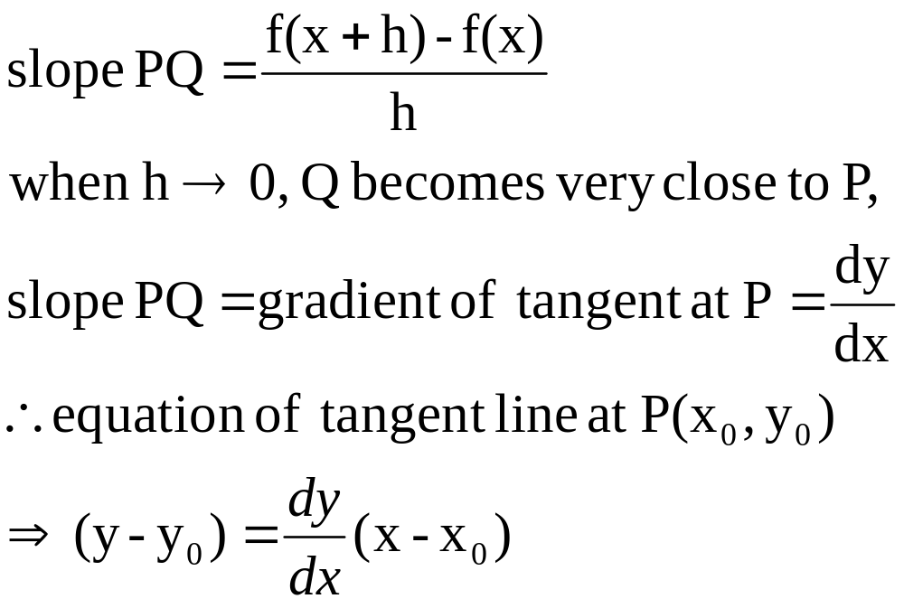
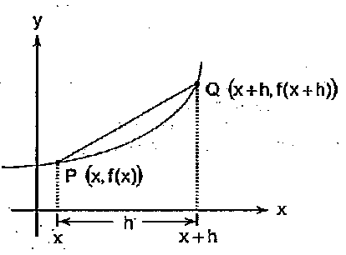
Tangent Lines

Slide 2
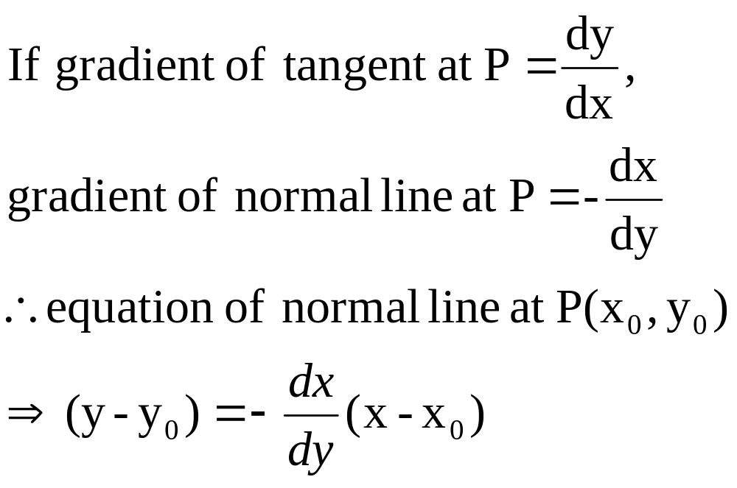
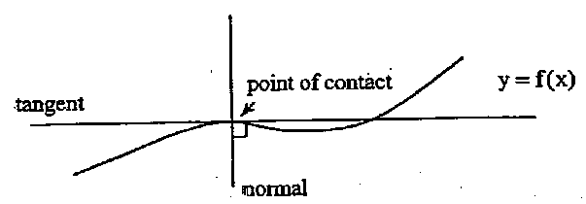
Tangent and Normal Lines

Slide 3
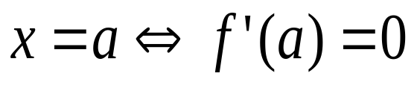
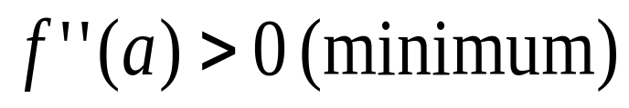
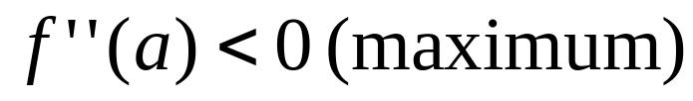
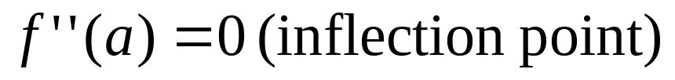

Stationary Points
There are 3 types:
Minimum
Maximum
Stationary inflection
Stationary points at
To determine the nature of the points:
-
-
-

Slide 4

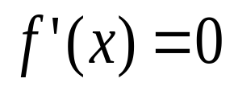
Stationary Points
Steps to find stationary points and its nature
Differentiate y with respect to x,
Find the values of x which
Find the values of y corresponding to each value of x from (b)
Examine the sign of dy/dx or second derivative to determine the nature

Slide 5
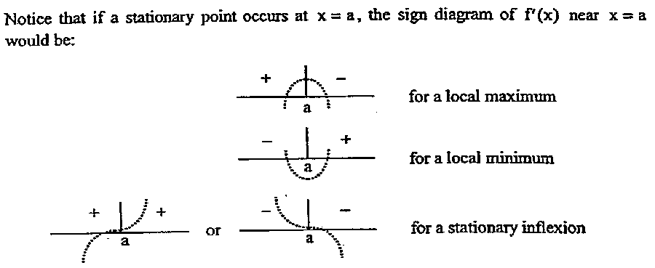
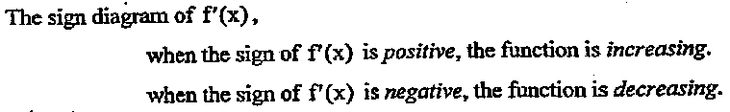
Stationary Points

Slide 6
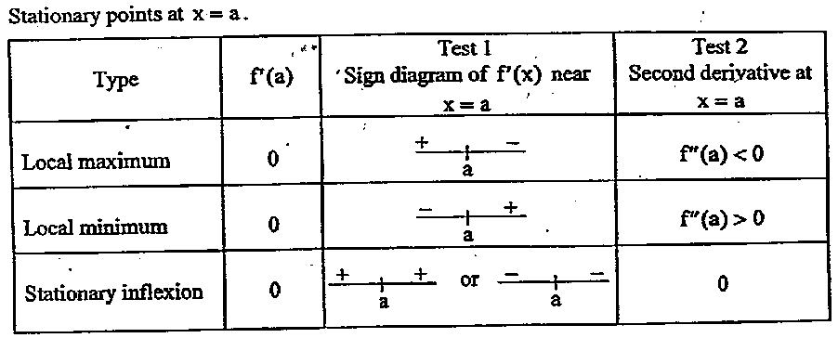
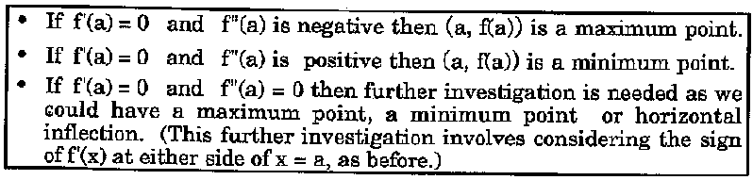
Stationary Points

Slide 7
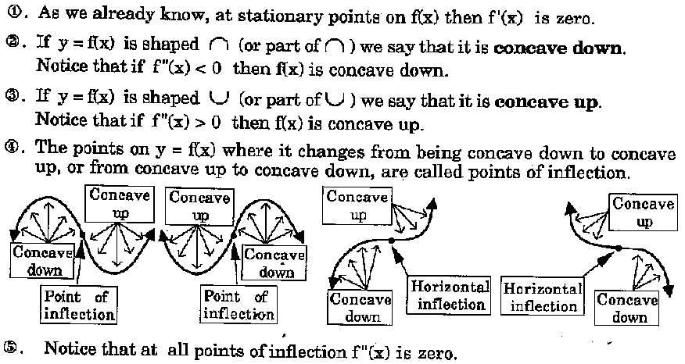
Sketching Polynomial Functions

Slide 8

Sketching Polynomial Functions
Steps to sketch a graph:
Find the y-intercept
Find the x-intercept
Examine the behavior as
Find any values of x for which the function is undefined (asymptote)
Find the stationary points
Find any other points of inflection
example

